Slide 1
Routing: Dijkstra’s Algorithm

Slide 2
Routing
Forwarding: Sending a packet over the next link along the path.
Routing: The process of discovering the “best” path from source to destination.
The network is modeled as a graph with edges representing links.
Routes will get updated to reflect network changes (e.g. link failures).

Slide 3
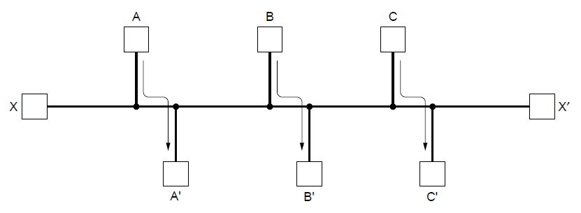
Routing
How do we define “best”?
Fewer hops?
Fastest?
Least loaded?
Most fair?
Cheapest???

Slide 4
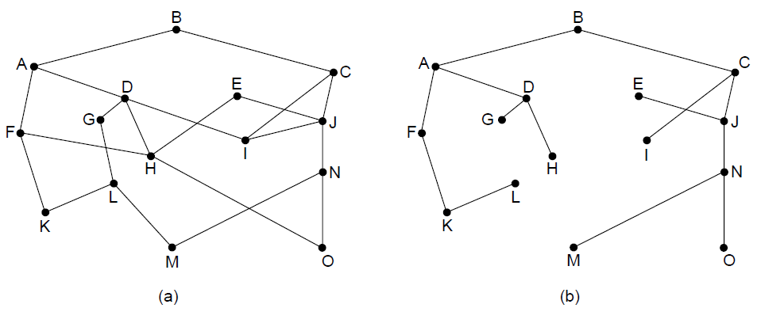
The Optimality Principle
(a) A network. (b) A sink tree for router B.
Each portion of a best path is also a best path.
Sink Tree: The union of best paths.
For a given graph, there may be multiple sink trees.
Here, “best” means fewest hops

Slide 5
Shortest Path Algorithm
Dijkstra’s algorithm computes the shortest path between a source and all destinations on a graph
Each link (edge) is assigned a non-negative weight
Weight (or distance) could be based on a number of metrics
If weight is 1 then the metric is hop count.
A shortest path is one with the lowest total weight

Slide 6
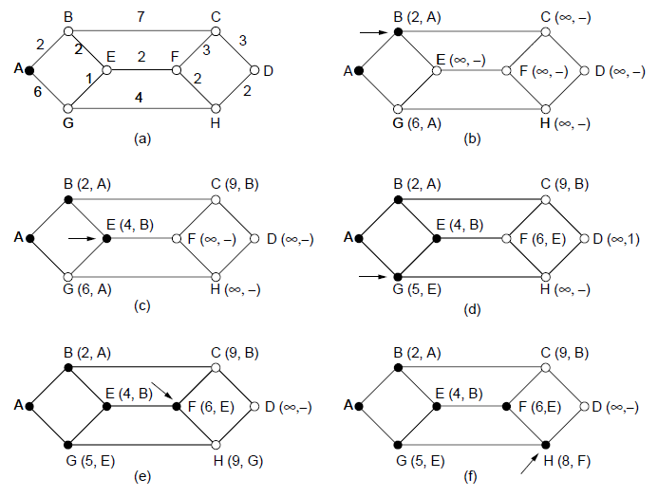
Shortest Path Algorithm
Step 2
Step 3
The first six steps used in computing the shortest path from A to D. Arrows indicate the working node.

